Slide 1
Counterinsurgency 101
1st Army (West) COIN Workshop
US Army and Marine Corps Counterinsurgency Center
http://coin.army.mil
Notes:
Time Required: ~ 30 minutes-1 hour depending on discussion
Task: Provide understanding of the differences between COIN and Conventional warfare
Learning Objectives:
COIN is Political in nature
Local Population is the center of the conflict

Slide 2
So what?
From Mens Journal, 21 Jan 09
…. A large blond soldier from the Pennsylvania National Guard whom we’ll call “Krieger” … wants to know whom our tiny lieutenant works for. “Human terrain,” Jones answers with panache. Krieger leans back and cocks a puzzled eyebrow. “You aren’t one of those HT assholes who wants to talk to the locals while I sit in my MRAP for 10 hours?”
Krieger is on a roll. “Hey, I talk to the Afghans. The last time I talked to an Afghan?” — Krieger launches into a violent pantomime of beating someone up, throwing him down on the ground, and zip-tying them — “was like that.”
Pretend–dusting himself off, he goes for the punch line. “And here he mimics crushing the invisible Afghan’s skull with his boots and then cutting his throat with his knife.

Slide 3
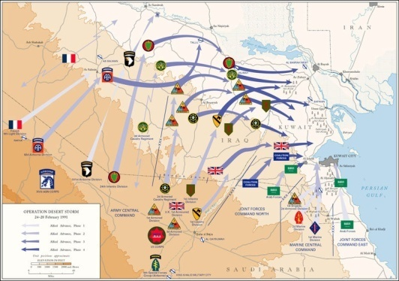
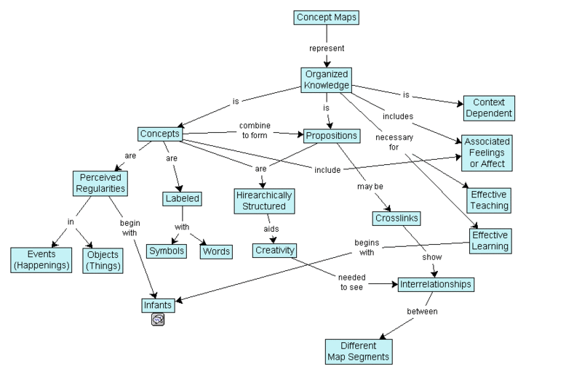
Counterinsurgency: A Mindset
Conventional war waged on physical terrain…
Counterinsurgency waged on human terrain…
Reading a human terrain map:
  Identify root causes
  View situations thru multiple cultural lenses
Human Environment Shapes Operations
Notes:
Takeaway: Battlefield is shifted from terrain to the population – we’re fighting over the minds of men as our terrain
Human Interactions are complex and non-linear – requires different mindset and approach.
----------
Realized during OIF I during self-study that had been doing things wrong; worked better during second tour;
long evolution from taking the objective to winning the population
What do you think I mean by “human terrain”?
Human terrain map is complex
Used to have ops shape environment, in COIN the environment shapes ops
Replace image with “complexity humans”

Slide 4
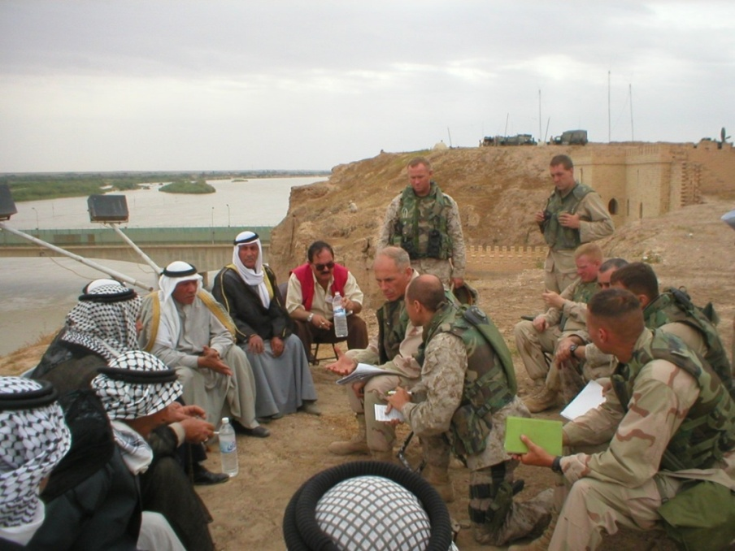
COIN Terrain
“I underestimated one factor… culture. I was looking at the wrong map – I needed to look at the tribal map not the geographic map.”
ISAF Multinational Brigade Commander, Kandahar
Establishing Relationships
Using Interpreter
Negotiating
Mediating
Arbitrating
Cultural understanding is key to success
Notes:
Takeaway: In COIN, things like Culture become as important as traditional military factors
Understand the “cultural terrain”
Seek understanding
Non-traditional military skillsets demanded
----------
What is the key terrain in the human terrain? Depends where you are; it’s contextual.
Change skillset block

Slide 5
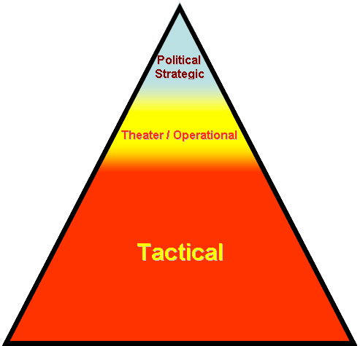
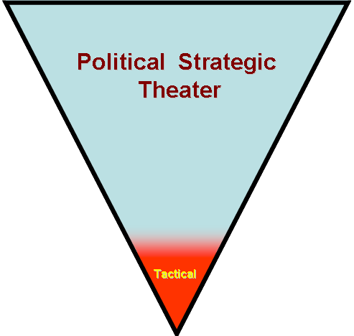
The Challenge to the Way We Think
How we tend to view things
How the insurgent views things
Tactical Actions used for Strategic Ends
© A Coord PowerPoint Ninja Graphic 2008
Notes:
Takeaway: The insurgent’s actions are designed to influence the political fight – tactical actions are used to achieve strategic ends; we tend to focus on tactical actions but often don’t connect to the political effect!
We’re “fighting past” each other, and we don’t understand why we win the battles but lose the war!
----------
Insurgents aren’t trying to get us to slant zero; they employ attacks for strategic effect
In my AO, we cycled through the Top Ten baddest guys list three times, but they kept creating insurgents

Slide 6
Insurgent’s Perspective
Political Mobilization is more important than Military Mobilization for a successful military outcome.
The enemy does not seek to defeat us through force of arms, but through political means
Notes:
Takeaway: COIN is Political in Nature – military means are used to political purpose
Give examples:
Vietnam
Soviets in Afghanistan
Public support in Iraq
Defeated in the public arena, not the battlefield

Slide 7
Why the Population?
“We have seen how indispensable the support of the population is to the guerrilla. It is possible for [the guerrilla] to exist only where the people give him their unqualified support. It is the inhabitant who supplies the guerrilla with his food supplies … ammunition … information … warning … [and] refuge”
- Roger Trinquier, Modern Warfare, Ch 9, 1964
Notes:
Why do people say the population is critical in COIN? (question to audience)
Takeaway: The insurgent support structure is the Population! It provides everything he needs … THEREFORE … if we deny him access and support of the population the insurgent cannot exist!
But how do we do that?
(Note the date, it isn’t new!)
----------
Why can’t I be enemy focused?
What we’ve done in the last couple of years in Iraq is separate the population from the insurgency
Example of market stalls (Chuck Bartles story)
ADD BOOK

Slide 8
Counterinsurgency Explained
HN Gov.
People
Insurgents
HN
Security
Forces
Notes:
This model reflects Counterinsurgency as a “Tug of War” between the people.
Build 1 Takeaway: In the beginning – there is population, government, and security forces
Build 2 Takeaway: To have an insurgency, there must be dissatisfaction that leads to discontent. That discontent can form an insurgency. The “root causes” are unique to each case, but are seized upon by the insurgent.
Build 3 Takeaway: The insurgents organize using their dynamics and begin to build support in the population and attack the govt. They also construct an alternate state concept and seek external support. The alternate state does not have to be practical, it is a motivating ideal.
Build 4: The government begins COIN, using COIN Principles to fight against the insurgent
Build 5: HN Governments also seek external support, which should ideally focus on reinforcing the HN security forces and governance. The government should address root causes and strengthen connection to the people.
Build 6: Successfully done, this denies the insurgent popular support, and his cause collapses.
----------
Questions from audience: What about economic recovery and infrastructure development? What about education? Answer: all part of COIN, but we want to soldier-level view

Slide 9
Counterinsurgency Explained
HN Gov.
People
Insurgents
HN
Security
Forces
Prerequisites
Root Causes
Notes:
This model reflects Counterinsurgency as a “Tug of War” between the people.
Build 1 Takeaway: In the beginning – there is population, government, and security forces
Build 2 Takeaway: To have an insurgency, there must be dissatisfaction that leads to discontent. That discontent can form an insurgency. The “root causes” are unique to each case, but are seized upon by the insurgent.
Build 3 Takeaway: The insurgents organize using their dynamics and begin to build support in the population and attack the govt. They also construct an alternate state concept and seek external support. The alternate state does not have to be practical, it is a motivating ideal.
Build 4: The government begins COIN, using COIN Principles to fight against the insurgent
Build 5: HN Governments also seek external support, which should ideally focus on reinforcing the HN security forces and governance. The government should address root causes and strengthen connection to the people.
Build 6: Successfully done, this denies the insurgent popular support, and his cause collapses.
----------
Questions from audience: What about economic recovery and infrastructure development? What about education? Answer: all part of COIN, but we want to soldier-level view

Slide 10
Counterinsurgency Explained
HN Gov.
People
Insurgents
HN
Security
Forces
Motivations
Prerequisites
Root Causes
Fear
Greed
Honor
Notes:
This model reflects Counterinsurgency as a “Tug of War” between the people.
Build 1 Takeaway: In the beginning – there is population, government, and security forces
Build 2 Takeaway: To have an insurgency, there must be dissatisfaction that leads to discontent. That discontent can form an insurgency. The “root causes” are unique to each case, but are seized upon by the insurgent.
Build 3 Takeaway: The insurgents organize using their dynamics and begin to build support in the population and attack the govt. They also construct an alternate state concept and seek external support. The alternate state does not have to be practical, it is a motivating ideal.
Build 4: The government begins COIN, using COIN Principles to fight against the insurgent
Build 5: HN Governments also seek external support, which should ideally focus on reinforcing the HN security forces and governance. The government should address root causes and strengthen connection to the people.
Build 6: Successfully done, this denies the insurgent popular support, and his cause collapses.
----------
Questions from audience: What about economic recovery and infrastructure development? What about education? Answer: all part of COIN, but we want to soldier-level view

Slide 11
Counterinsurgency Explained
HN Gov.
People
Insurgents
HN
Security
Forces
Insurgents
Prerequisites
Root Causes
Motivations
Fear
Greed
Honor
Notes:
This model reflects Counterinsurgency as a “Tug of War” between the people.
Build 1 Takeaway: In the beginning – there is population, government, and security forces
Build 2 Takeaway: To have an insurgency, there must be dissatisfaction that leads to discontent. That discontent can form an insurgency. The “root causes” are unique to each case, but are seized upon by the insurgent.
Build 3 Takeaway: The insurgents organize using their dynamics and begin to build support in the population and attack the govt. They also construct an alternate state concept and seek external support. The alternate state does not have to be practical, it is a motivating ideal.
Build 4: The government begins COIN, using COIN Principles to fight against the insurgent
Build 5: HN Governments also seek external support, which should ideally focus on reinforcing the HN security forces and governance. The government should address root causes and strengthen connection to the people.
Build 6: Successfully done, this denies the insurgent popular support, and his cause collapses.
----------
Questions from audience: What about economic recovery and infrastructure development? What about education? Answer: all part of COIN, but we want to soldier-level view

Slide 12
Counterinsurgency Explained
HN Gov.
People
Insurgents
HN
Security
Forces
Insurgents
Insurgency
Dynamics
Prerequisites
Root Causes
Motivations
Fear
Greed
Honor
Notes:
This model reflects Counterinsurgency as a “Tug of War” between the people.
Build 1 Takeaway: In the beginning – there is population, government, and security forces
Build 2 Takeaway: To have an insurgency, there must be dissatisfaction that leads to discontent. That discontent can form an insurgency. The “root causes” are unique to each case, but are seized upon by the insurgent.
Build 3 Takeaway: The insurgents organize using their dynamics and begin to build support in the population and attack the govt. They also construct an alternate state concept and seek external support. The alternate state does not have to be practical, it is a motivating ideal.
Build 4: The government begins COIN, using COIN Principles to fight against the insurgent
Build 5: HN Governments also seek external support, which should ideally focus on reinforcing the HN security forces and governance. The government should address root causes and strengthen connection to the people.
Build 6: Successfully done, this denies the insurgent popular support, and his cause collapses.
----------
Questions from audience: What about economic recovery and infrastructure development? What about education? Answer: all part of COIN, but we want to soldier-level view

Slide 13
Counterinsurgency Explained
HN Gov.
People
Insurgents
Psychological
HN
Security
Forces
Insurgents
Insurgency
Dynamics
Leadership
Prerequisites
Root Causes
Motivations
Fear
Greed
Honor
Notes:
This model reflects Counterinsurgency as a “Tug of War” between the people.
Build 1 Takeaway: In the beginning – there is population, government, and security forces
Build 2 Takeaway: To have an insurgency, there must be dissatisfaction that leads to discontent. That discontent can form an insurgency. The “root causes” are unique to each case, but are seized upon by the insurgent.
Build 3 Takeaway: The insurgents organize using their dynamics and begin to build support in the population and attack the govt. They also construct an alternate state concept and seek external support. The alternate state does not have to be practical, it is a motivating ideal.
Build 4: The government begins COIN, using COIN Principles to fight against the insurgent
Build 5: HN Governments also seek external support, which should ideally focus on reinforcing the HN security forces and governance. The government should address root causes and strengthen connection to the people.
Build 6: Successfully done, this denies the insurgent popular support, and his cause collapses.
----------
Questions from audience: What about economic recovery and infrastructure development? What about education? Answer: all part of COIN, but we want to soldier-level view

Slide 14
Counterinsurgency Explained
HN Gov.
Alternate
State
People
Psychological
Insurgents
Psychological
HN
Security
Forces
Insurgents
Insurgency
Dynamics
Leadership
Prerequisites
Root Causes
Motivations
Ideology
Fear
Greed
Honor
Notes:
This model reflects Counterinsurgency as a “Tug of War” between the people.
Build 1 Takeaway: In the beginning – there is population, government, and security forces
Build 2 Takeaway: To have an insurgency, there must be dissatisfaction that leads to discontent. That discontent can form an insurgency. The “root causes” are unique to each case, but are seized upon by the insurgent.
Build 3 Takeaway: The insurgents organize using their dynamics and begin to build support in the population and attack the govt. They also construct an alternate state concept and seek external support. The alternate state does not have to be practical, it is a motivating ideal.
Build 4: The government begins COIN, using COIN Principles to fight against the insurgent
Build 5: HN Governments also seek external support, which should ideally focus on reinforcing the HN security forces and governance. The government should address root causes and strengthen connection to the people.
Build 6: Successfully done, this denies the insurgent popular support, and his cause collapses.
----------
Questions from audience: What about economic recovery and infrastructure development? What about education? Answer: all part of COIN, but we want to soldier-level view

Slide 15
Counterinsurgency Explained
HN Gov.
Alternate
State
People
Psychological
Physical
Insurgents
Psychological
HN
Security
Forces
Physical
Insurgents
Insurgency
Dynamics
Leadership
Prerequisites
Root Causes
Motivations
Ideology
Fear
Greed
Honor
Objective
Notes:
This model reflects Counterinsurgency as a “Tug of War” between the people.
Build 1 Takeaway: In the beginning – there is population, government, and security forces
Build 2 Takeaway: To have an insurgency, there must be dissatisfaction that leads to discontent. That discontent can form an insurgency. The “root causes” are unique to each case, but are seized upon by the insurgent.
Build 3 Takeaway: The insurgents organize using their dynamics and begin to build support in the population and attack the govt. They also construct an alternate state concept and seek external support. The alternate state does not have to be practical, it is a motivating ideal.
Build 4: The government begins COIN, using COIN Principles to fight against the insurgent
Build 5: HN Governments also seek external support, which should ideally focus on reinforcing the HN security forces and governance. The government should address root causes and strengthen connection to the people.
Build 6: Successfully done, this denies the insurgent popular support, and his cause collapses.
----------
Questions from audience: What about economic recovery and infrastructure development? What about education? Answer: all part of COIN, but we want to soldier-level view

Slide 16
Counterinsurgency Explained
HN Gov.
Alternate
State
People
Psychological
Physical
Insurgents
Psychological
HN
Security
Forces
Physical
Insurgents
Insurgency
Dynamics
Leadership
Prerequisites
Root Causes
Motivations
Ideology
Fear
Greed
Honor
Objective
Environment
Notes:
This model reflects Counterinsurgency as a “Tug of War” between the people.
Build 1 Takeaway: In the beginning – there is population, government, and security forces
Build 2 Takeaway: To have an insurgency, there must be dissatisfaction that leads to discontent. That discontent can form an insurgency. The “root causes” are unique to each case, but are seized upon by the insurgent.
Build 3 Takeaway: The insurgents organize using their dynamics and begin to build support in the population and attack the govt. They also construct an alternate state concept and seek external support. The alternate state does not have to be practical, it is a motivating ideal.
Build 4: The government begins COIN, using COIN Principles to fight against the insurgent
Build 5: HN Governments also seek external support, which should ideally focus on reinforcing the HN security forces and governance. The government should address root causes and strengthen connection to the people.
Build 6: Successfully done, this denies the insurgent popular support, and his cause collapses.
----------
Questions from audience: What about economic recovery and infrastructure development? What about education? Answer: all part of COIN, but we want to soldier-level view

Slide 17
Counterinsurgency Explained
HN Gov.
Alternate
State
People
Psychological
Political
Moral
Physical
External
(Non)State
Actor
Insurgents
Psychological
Resources
Sanctuary
HN
Security
Forces
Physical
Insurgents
Insurgency
Dynamics
Leadership
Prerequisites
Root Causes
Motivations
Ideology
Fear
Greed
Honor
Objective
Environment
External Support
Notes:
This model reflects Counterinsurgency as a “Tug of War” between the people.
Build 1 Takeaway: In the beginning – there is population, government, and security forces
Build 2 Takeaway: To have an insurgency, there must be dissatisfaction that leads to discontent. That discontent can form an insurgency. The “root causes” are unique to each case, but are seized upon by the insurgent.
Build 3 Takeaway: The insurgents organize using their dynamics and begin to build support in the population and attack the govt. They also construct an alternate state concept and seek external support. The alternate state does not have to be practical, it is a motivating ideal.
Build 4: The government begins COIN, using COIN Principles to fight against the insurgent
Build 5: HN Governments also seek external support, which should ideally focus on reinforcing the HN security forces and governance. The government should address root causes and strengthen connection to the people.
Build 6: Successfully done, this denies the insurgent popular support, and his cause collapses.
----------
Questions from audience: What about economic recovery and infrastructure development? What about education? Answer: all part of COIN, but we want to soldier-level view

Slide 18
Counterinsurgency Explained
HN Gov.
Alternate
State
People
Psychological
Political
Moral
Physical
External
(Non)State
Actor
Insurgents
Psychological
Resources
Sanctuary
HN
Security
Forces
Physical
Insurgents
Insurgency
Dynamics
Leadership
Prerequisites
Root Causes
Motivations
Ideology
Fear
Greed
Honor
Objective
Environment
External Support
Phases
Notes:
This model reflects Counterinsurgency as a “Tug of War” between the people.
Build 1 Takeaway: In the beginning – there is population, government, and security forces
Build 2 Takeaway: To have an insurgency, there must be dissatisfaction that leads to discontent. That discontent can form an insurgency. The “root causes” are unique to each case, but are seized upon by the insurgent.
Build 3 Takeaway: The insurgents organize using their dynamics and begin to build support in the population and attack the govt. They also construct an alternate state concept and seek external support. The alternate state does not have to be practical, it is a motivating ideal.
Build 4: The government begins COIN, using COIN Principles to fight against the insurgent
Build 5: HN Governments also seek external support, which should ideally focus on reinforcing the HN security forces and governance. The government should address root causes and strengthen connection to the people.
Build 6: Successfully done, this denies the insurgent popular support, and his cause collapses.
----------
Questions from audience: What about economic recovery and infrastructure development? What about education? Answer: all part of COIN, but we want to soldier-level view

Slide 19
Counterinsurgency Explained
HN Gov.
Alternate
State
People
Psychological
Political
Moral
Physical
External
(Non)State
Actor
Insurgents
Psychological
Resources
Sanctuary
HN
Security
Forces
Physical
Insurgents
Insurgency
Dynamics
Leadership
Prerequisites
Root Causes
Motivations
Ideology
Fear
Greed
Honor
Objective
Environment
External Support
Phases
Organization
Notes:
This model reflects Counterinsurgency as a “Tug of War” between the people.
Build 1 Takeaway: In the beginning – there is population, government, and security forces
Build 2 Takeaway: To have an insurgency, there must be dissatisfaction that leads to discontent. That discontent can form an insurgency. The “root causes” are unique to each case, but are seized upon by the insurgent.
Build 3 Takeaway: The insurgents organize using their dynamics and begin to build support in the population and attack the govt. They also construct an alternate state concept and seek external support. The alternate state does not have to be practical, it is a motivating ideal.
Build 4: The government begins COIN, using COIN Principles to fight against the insurgent
Build 5: HN Governments also seek external support, which should ideally focus on reinforcing the HN security forces and governance. The government should address root causes and strengthen connection to the people.
Build 6: Successfully done, this denies the insurgent popular support, and his cause collapses.
----------
Questions from audience: What about economic recovery and infrastructure development? What about education? Answer: all part of COIN, but we want to soldier-level view

Slide 20
Counterinsurgency Explained
HN Gov.
Alternate
State
People
Psychological
Political
Moral
Coalition
Civ
Physical
External
(Non)State
Actor
Military
Insurgents
Psychological
Resources
Sanctuary
HN
Security
Forces
Physical
COIN Principles
Insurgents
Insurgency
Dynamics
Leadership
Prerequisites
Root Causes
Motivations
Ideology
Fear
Greed
Honor
Objective
Environment
External Support
Phases
Organization
Notes:
This model reflects Counterinsurgency as a “Tug of War” between the people.
Build 1 Takeaway: In the beginning – there is population, government, and security forces
Build 2 Takeaway: To have an insurgency, there must be dissatisfaction that leads to discontent. That discontent can form an insurgency. The “root causes” are unique to each case, but are seized upon by the insurgent.
Build 3 Takeaway: The insurgents organize using their dynamics and begin to build support in the population and attack the govt. They also construct an alternate state concept and seek external support. The alternate state does not have to be practical, it is a motivating ideal.
Build 4: The government begins COIN, using COIN Principles to fight against the insurgent
Build 5: HN Governments also seek external support, which should ideally focus on reinforcing the HN security forces and governance. The government should address root causes and strengthen connection to the people.
Build 6: Successfully done, this denies the insurgent popular support, and his cause collapses.
----------
Questions from audience: What about economic recovery and infrastructure development? What about education? Answer: all part of COIN, but we want to soldier-level view

Slide 21
Counterinsurgency Explained
HN Gov.
Alternate
State
People
Psychological
Political
Moral
Coalition
Civ
Physical
External
(Non)State
Actor
Military
Insurgents
Psychological
Military
Resources
Sanctuary
HN
Security
Forces
Physical
Physical
COIN Principles
Insurgents
Insurgency
Dynamics
Legitimacy
Leadership
Prerequisites
Root Causes
Motivations
Ideology
Fear
Greed
Honor
Objective
Environment
External Support
Phases
Organization
Notes:
This model reflects Counterinsurgency as a “Tug of War” between the people.
Build 1 Takeaway: In the beginning – there is population, government, and security forces
Build 2 Takeaway: To have an insurgency, there must be dissatisfaction that leads to discontent. That discontent can form an insurgency. The “root causes” are unique to each case, but are seized upon by the insurgent.
Build 3 Takeaway: The insurgents organize using their dynamics and begin to build support in the population and attack the govt. They also construct an alternate state concept and seek external support. The alternate state does not have to be practical, it is a motivating ideal.
Build 4: The government begins COIN, using COIN Principles to fight against the insurgent
Build 5: HN Governments also seek external support, which should ideally focus on reinforcing the HN security forces and governance. The government should address root causes and strengthen connection to the people.
Build 6: Successfully done, this denies the insurgent popular support, and his cause collapses.
----------
Questions from audience: What about economic recovery and infrastructure development? What about education? Answer: all part of COIN, but we want to soldier-level view

Slide 22
Counterinsurgency Explained
HN Gov.
Alternate
State
People
Psychological
Psychological
Political
Political
Moral
Coalition
Civ
Physical
Physical
External
(Non)State
Actor
Military
Insurgents
Psychological
Psychological
Military
Resources
Sanctuary
HN
Security
Forces
Physical
Physical
COIN Principles
Insurgents
Insurgency
Dynamics
Legitimacy
Unity of Effort
Leadership
Prerequisites
Root Causes
Motivations
Ideology
Fear
Greed
Honor
Objective
Environment
External Support
Phases
Organization
Notes:
This model reflects Counterinsurgency as a “Tug of War” between the people.
Build 1 Takeaway: In the beginning – there is population, government, and security forces
Build 2 Takeaway: To have an insurgency, there must be dissatisfaction that leads to discontent. That discontent can form an insurgency. The “root causes” are unique to each case, but are seized upon by the insurgent.
Build 3 Takeaway: The insurgents organize using their dynamics and begin to build support in the population and attack the govt. They also construct an alternate state concept and seek external support. The alternate state does not have to be practical, it is a motivating ideal.
Build 4: The government begins COIN, using COIN Principles to fight against the insurgent
Build 5: HN Governments also seek external support, which should ideally focus on reinforcing the HN security forces and governance. The government should address root causes and strengthen connection to the people.
Build 6: Successfully done, this denies the insurgent popular support, and his cause collapses.
----------
Questions from audience: What about economic recovery and infrastructure development? What about education? Answer: all part of COIN, but we want to soldier-level view

Slide 23
Counterinsurgency Explained
HN Gov.
Alternate
State
People
Psychological
Psychological
Political
Political
Moral
Coalition
Civ
Physical
Physical
External
(Non)State
Actor
Military
Insurgents
Psychological
Psychological
Military
Resources
Sanctuary
HN
Security
Forces
Physical
Physical
COIN Principles
Insurgents
Insurgency
Dynamics
Legitimacy
Unity of Effort
Leadership
Political is Primary
Prerequisites
Root Causes
Motivations
Ideology
Fear
Greed
Honor
Objective
Environment
External Support
Phases
Organization
Notes:
This model reflects Counterinsurgency as a “Tug of War” between the people.
Build 1 Takeaway: In the beginning – there is population, government, and security forces
Build 2 Takeaway: To have an insurgency, there must be dissatisfaction that leads to discontent. That discontent can form an insurgency. The “root causes” are unique to each case, but are seized upon by the insurgent.
Build 3 Takeaway: The insurgents organize using their dynamics and begin to build support in the population and attack the govt. They also construct an alternate state concept and seek external support. The alternate state does not have to be practical, it is a motivating ideal.
Build 4: The government begins COIN, using COIN Principles to fight against the insurgent
Build 5: HN Governments also seek external support, which should ideally focus on reinforcing the HN security forces and governance. The government should address root causes and strengthen connection to the people.
Build 6: Successfully done, this denies the insurgent popular support, and his cause collapses.
----------
Questions from audience: What about economic recovery and infrastructure development? What about education? Answer: all part of COIN, but we want to soldier-level view

Slide 24
Counterinsurgency Explained
HN Gov.
Alternate
State
People
Psychological
Psychological
Political
Political
Moral
Coalition
Civ
Physical
Physical
External
(Non)State
Actor
Military
Insurgents
Psychological
Psychological
Military
Resources
Sanctuary
HN
Security
Forces
Physical
Physical
COIN Principles
Insurgents
Insurgency
Dynamics
Legitimacy
Unity of Effort
Leadership
Political is Primary
Prerequisites
Root Causes
Motivations
Ideology
Understand the Environment
Fear
Greed
Honor
Objective
Environment
External Support
Phases
Organization
Notes:
This model reflects Counterinsurgency as a “Tug of War” between the people.
Build 1 Takeaway: In the beginning – there is population, government, and security forces
Build 2 Takeaway: To have an insurgency, there must be dissatisfaction that leads to discontent. That discontent can form an insurgency. The “root causes” are unique to each case, but are seized upon by the insurgent.
Build 3 Takeaway: The insurgents organize using their dynamics and begin to build support in the population and attack the govt. They also construct an alternate state concept and seek external support. The alternate state does not have to be practical, it is a motivating ideal.
Build 4: The government begins COIN, using COIN Principles to fight against the insurgent
Build 5: HN Governments also seek external support, which should ideally focus on reinforcing the HN security forces and governance. The government should address root causes and strengthen connection to the people.
Build 6: Successfully done, this denies the insurgent popular support, and his cause collapses.
----------
Questions from audience: What about economic recovery and infrastructure development? What about education? Answer: all part of COIN, but we want to soldier-level view

Slide 25
Counterinsurgency Explained
HN Gov.
Alternate
State
People
Psychological
Psychological
Political
Political
Moral
Coalition
Civ
Physical
Physical
External
(Non)State
Actor
Military
Insurgents
Psychological
Psychological
Military
Resources
Sanctuary
HN
Security
Forces
Physical
Physical
COIN Principles
Insurgents
Insurgency
Dynamics
Legitimacy
Unity of Effort
Leadership
Political is Primary
Prerequisites
Root Causes
Motivations
Ideology
Understand the Environment
Fear
Greed
Honor
Objective
Intelligence
Environment
External Support
Phases
Organization
Notes:
This model reflects Counterinsurgency as a “Tug of War” between the people.
Build 1 Takeaway: In the beginning – there is population, government, and security forces
Build 2 Takeaway: To have an insurgency, there must be dissatisfaction that leads to discontent. That discontent can form an insurgency. The “root causes” are unique to each case, but are seized upon by the insurgent.
Build 3 Takeaway: The insurgents organize using their dynamics and begin to build support in the population and attack the govt. They also construct an alternate state concept and seek external support. The alternate state does not have to be practical, it is a motivating ideal.
Build 4: The government begins COIN, using COIN Principles to fight against the insurgent
Build 5: HN Governments also seek external support, which should ideally focus on reinforcing the HN security forces and governance. The government should address root causes and strengthen connection to the people.
Build 6: Successfully done, this denies the insurgent popular support, and his cause collapses.
----------
Questions from audience: What about economic recovery and infrastructure development? What about education? Answer: all part of COIN, but we want to soldier-level view

Slide 26
Counterinsurgency Explained
HN Gov.
Alternate
State
People
Psychological
Psychological
Political
Political
Moral
Coalition
Civ
Physical
Physical
External
(Non)State
Actor
Military
Insurgents
Psychological
Psychological
Military
Resources
Sanctuary
HN
Security
Forces
Physical
Physical
COIN Principles
Insurgents
Insurgency
Dynamics
Legitimacy
Unity of Effort
Leadership
Political is Primary
Prerequisites
Root Causes
Motivations
Ideology
Understand the Environment
Fear
Greed
Honor
Objective
Intelligence
Environment
Isolate Insurgents
External Support
Phases
Organization
Notes:
This model reflects Counterinsurgency as a “Tug of War” between the people.
Build 1 Takeaway: In the beginning – there is population, government, and security forces
Build 2 Takeaway: To have an insurgency, there must be dissatisfaction that leads to discontent. That discontent can form an insurgency. The “root causes” are unique to each case, but are seized upon by the insurgent.
Build 3 Takeaway: The insurgents organize using their dynamics and begin to build support in the population and attack the govt. They also construct an alternate state concept and seek external support. The alternate state does not have to be practical, it is a motivating ideal.
Build 4: The government begins COIN, using COIN Principles to fight against the insurgent
Build 5: HN Governments also seek external support, which should ideally focus on reinforcing the HN security forces and governance. The government should address root causes and strengthen connection to the people.
Build 6: Successfully done, this denies the insurgent popular support, and his cause collapses.
----------
Questions from audience: What about economic recovery and infrastructure development? What about education? Answer: all part of COIN, but we want to soldier-level view

Slide 27
Counterinsurgency Explained
HN Gov.
Alternate
State
People
Psychological
Psychological
Political
Political
Moral
Coalition
Civ
Physical
Physical
External
(Non)State
Actor
Military
Insurgents
Psychological
Psychological
Military
Resources
Sanctuary
HN
Security
Forces
Physical
Physical
COIN Principles
Insurgents
Insurgency
Dynamics
Legitimacy
Unity of Effort
Leadership
Political is Primary
Prerequisites
Root Causes
Motivations
Ideology
Understand the Environment
Fear
Greed
Honor
Objective
Intelligence
Environment
Isolate Insurgents
External Support
Security under Rule of Law
Phases
Organization
Notes:
This model reflects Counterinsurgency as a “Tug of War” between the people.
Build 1 Takeaway: In the beginning – there is population, government, and security forces
Build 2 Takeaway: To have an insurgency, there must be dissatisfaction that leads to discontent. That discontent can form an insurgency. The “root causes” are unique to each case, but are seized upon by the insurgent.
Build 3 Takeaway: The insurgents organize using their dynamics and begin to build support in the population and attack the govt. They also construct an alternate state concept and seek external support. The alternate state does not have to be practical, it is a motivating ideal.
Build 4: The government begins COIN, using COIN Principles to fight against the insurgent
Build 5: HN Governments also seek external support, which should ideally focus on reinforcing the HN security forces and governance. The government should address root causes and strengthen connection to the people.
Build 6: Successfully done, this denies the insurgent popular support, and his cause collapses.
----------
Questions from audience: What about economic recovery and infrastructure development? What about education? Answer: all part of COIN, but we want to soldier-level view

Slide 28
Counterinsurgency Explained
HN Gov.
Alternate
State
People
Psychological
Psychological
Political
Political
Moral
Coalition
Civ
Physical
Physical
External
(Non)State
Actor
Military
Insurgents
Psychological
Psychological
Military
Resources
Sanctuary
HN
Security
Forces
Physical
Physical
COIN Principles
Insurgents
Insurgency
Dynamics
Legitimacy
Unity of Effort
Leadership
Political is Primary
Prerequisites
Root Causes
Motivations
Ideology
Understand the Environment
Fear
Greed
Honor
Objective
Intelligence
Environment
Isolate Insurgents
External Support
Security under Rule of Law
Phases
Long term Commitment
Organization
Notes:
This model reflects Counterinsurgency as a “Tug of War” between the people.
Build 1 Takeaway: In the beginning – there is population, government, and security forces
Build 2 Takeaway: To have an insurgency, there must be dissatisfaction that leads to discontent. That discontent can form an insurgency. The “root causes” are unique to each case, but are seized upon by the insurgent.
Build 3 Takeaway: The insurgents organize using their dynamics and begin to build support in the population and attack the govt. They also construct an alternate state concept and seek external support. The alternate state does not have to be practical, it is a motivating ideal.
Build 4: The government begins COIN, using COIN Principles to fight against the insurgent
Build 5: HN Governments also seek external support, which should ideally focus on reinforcing the HN security forces and governance. The government should address root causes and strengthen connection to the people.
Build 6: Successfully done, this denies the insurgent popular support, and his cause collapses.
----------
Questions from audience: What about economic recovery and infrastructure development? What about education? Answer: all part of COIN, but we want to soldier-level view

Slide 29
Counterinsurgency Explained
People
HN Gov.
Alternate
State
Psychological
Psychological
Political
Political
Moral
Coalition
Civ
Physical
Physical
External
(Non)State
Actor
Military
Insurgents
Psychological
Psychological
Military
Resources
Sanctuary
HN
Security
Forces
Physical
Physical
COIN Principles
Insurgents
Insurgency
Dynamics
Legitimacy
Unity of Effort
Leadership
Political is Primary
Prerequisites
Root Causes
Motivations
Ideology
Understand the Environment
Fear
Greed
Honor
Objective
Intelligence
Environment
Isolate Insurgents
External Support
Security under Rule of Law
Phases
Long term Commitment
Organization
Notes:
This model reflects Counterinsurgency as a “Tug of War” between the people.
Build 1 Takeaway: In the beginning – there is population, government, and security forces
Build 2 Takeaway: To have an insurgency, there must be dissatisfaction that leads to discontent. That discontent can form an insurgency. The “root causes” are unique to each case, but are seized upon by the insurgent.
Build 3 Takeaway: The insurgents organize using their dynamics and begin to build support in the population and attack the govt. They also construct an alternate state concept and seek external support. The alternate state does not have to be practical, it is a motivating ideal.
Build 4: The government begins COIN, using COIN Principles to fight against the insurgent
Build 5: HN Governments also seek external support, which should ideally focus on reinforcing the HN security forces and governance. The government should address root causes and strengthen connection to the people.
Build 6: Successfully done, this denies the insurgent popular support, and his cause collapses.
----------
Questions from audience: What about economic recovery and infrastructure development? What about education? Answer: all part of COIN, but we want to soldier-level view

Slide 30
Counterinsurgency Explained
Approach to Counterinsurgency
People
HN Gov.
Alternate
State
Psychological
Psychological
Political
Political
Moral
Coalition
Civ
Physical
Physical
External
(Non)State
Actor
Military
Insurgents
Psychological
Psychological
Military
Resources
Sanctuary
HN
Security
Forces
Physical
Physical
COIN Principles
Insurgents
Insurgency
Dynamics
Legitimacy
Unity of Effort
Leadership
Political is Primary
Prerequisites
Root Causes
Motivations
Ideology
Understand the Environment
Fear
Greed
Honor
Objective
Intelligence
Environment
Isolate Insurgents
External Support
Security under Rule of Law
Phases
Long term Commitment
Organization
Notes:
This model reflects Counterinsurgency as a “Tug of War” between the people.
Build 1 Takeaway: In the beginning – there is population, government, and security forces
Build 2 Takeaway: To have an insurgency, there must be dissatisfaction that leads to discontent. That discontent can form an insurgency. The “root causes” are unique to each case, but are seized upon by the insurgent.
Build 3 Takeaway: The insurgents organize using their dynamics and begin to build support in the population and attack the govt. They also construct an alternate state concept and seek external support. The alternate state does not have to be practical, it is a motivating ideal.
Build 4: The government begins COIN, using COIN Principles to fight against the insurgent
Build 5: HN Governments also seek external support, which should ideally focus on reinforcing the HN security forces and governance. The government should address root causes and strengthen connection to the people.
Build 6: Successfully done, this denies the insurgent popular support, and his cause collapses.
----------
Questions from audience: What about economic recovery and infrastructure development? What about education? Answer: all part of COIN, but we want to soldier-level view

Slide 31
Counterinsurgency Explained
Approach to Counterinsurgency
1. Separate insurgents from Population
People
HN Gov.
Alternate
State
Psychological
Psychological
Political
Political
Moral
Coalition
Civ
Physical
Physical
External
(Non)State
Actor
Military
Insurgents
Partner Unit
TT/OMLT
Psychological
Psychological
Military
Resources
Sanctuary
HN
Security
Forces
Physical
Physical
COIN Principles
Insurgents
Insurgency
Dynamics
Legitimacy
Unity of Effort
Leadership
Political is Primary
Prerequisites
Root Causes
Motivations
Ideology
Understand the Environment
Fear
Greed
Honor
Objective
Intelligence
Environment
Isolate Insurgents
External Support
Security under Rule of Law
Phases
Long term Commitment
Organization
Notes:
This model reflects Counterinsurgency as a “Tug of War” between the people.
Build 1 Takeaway: In the beginning – there is population, government, and security forces
Build 2 Takeaway: To have an insurgency, there must be dissatisfaction that leads to discontent. That discontent can form an insurgency. The “root causes” are unique to each case, but are seized upon by the insurgent.
Build 3 Takeaway: The insurgents organize using their dynamics and begin to build support in the population and attack the govt. They also construct an alternate state concept and seek external support. The alternate state does not have to be practical, it is a motivating ideal.
Build 4: The government begins COIN, using COIN Principles to fight against the insurgent
Build 5: HN Governments also seek external support, which should ideally focus on reinforcing the HN security forces and governance. The government should address root causes and strengthen connection to the people.
Build 6: Successfully done, this denies the insurgent popular support, and his cause collapses.
----------
Questions from audience: What about economic recovery and infrastructure development? What about education? Answer: all part of COIN, but we want to soldier-level view

Slide 32
Counterinsurgency Explained
Approach to Counterinsurgency
1. Separate insurgents from Population
2. Connect Population to Government
People
HN Gov.
Alternate
State
Psychological
Psychological
Political
Political
Moral
Coalition
PRTs
Physical
Physical
Civ
External
(Non)State
Actor
Military
Insurgents
Partner Unit
TT/OMLT
Psychological
Psychological
Military
Resources
Sanctuary
HN
Security
Forces
Physical
Physical
COIN Principles
Insurgents
Insurgency
Dynamics
Legitimacy
Unity of Effort
Leadership
Political is Primary
Prerequisites
Root Causes
Motivations
Ideology
Understand the Environment
Fear
Greed
Honor
Objective
Intelligence
Environment
Isolate Insurgents
External Support
Security under Rule of Law
Phases
Long term Commitment
Organization
Notes:
This model reflects Counterinsurgency as a “Tug of War” between the people.
Build 1 Takeaway: In the beginning – there is population, government, and security forces
Build 2 Takeaway: To have an insurgency, there must be dissatisfaction that leads to discontent. That discontent can form an insurgency. The “root causes” are unique to each case, but are seized upon by the insurgent.
Build 3 Takeaway: The insurgents organize using their dynamics and begin to build support in the population and attack the govt. They also construct an alternate state concept and seek external support. The alternate state does not have to be practical, it is a motivating ideal.
Build 4: The government begins COIN, using COIN Principles to fight against the insurgent
Build 5: HN Governments also seek external support, which should ideally focus on reinforcing the HN security forces and governance. The government should address root causes and strengthen connection to the people.
Build 6: Successfully done, this denies the insurgent popular support, and his cause collapses.
----------
Questions from audience: What about economic recovery and infrastructure development? What about education? Answer: all part of COIN, but we want to soldier-level view

Slide 33
Counterinsurgency Explained
Approach to Counterinsurgency
1. Separate insurgents from Population
2. Connect Population to Government
3. Transform Environment to be
inhospitable to Insurgents
People
HN Gov.
Alternate
State
Psychological
Psychological
Political
Political
Moral
Coalition
PRTs
Physical
Physical
Civ
External
(Non)State
Actor
Military
Insurgents
Partner Unit
TT/OMLT
Psychological
Psychological
Military
Resources
Sanctuary
HN
Security
Forces
Physical
Physical
COIN Principles
Insurgents
Insurgency
Dynamics
Legitimacy
Unity of Effort
Leadership
Political is Primary
Prerequisites
Root Causes
Motivations
Ideology
Understand the Environment
Fear
Greed
Honor
Objective
Intelligence
Environment
Isolate Insurgents
External Support
Security under Rule of Law
Phases
Long term Commitment
Organization
Notes:
This model reflects Counterinsurgency as a “Tug of War” between the people.
Build 1 Takeaway: In the beginning – there is population, government, and security forces
Build 2 Takeaway: To have an insurgency, there must be dissatisfaction that leads to discontent. That discontent can form an insurgency. The “root causes” are unique to each case, but are seized upon by the insurgent.
Build 3 Takeaway: The insurgents organize using their dynamics and begin to build support in the population and attack the govt. They also construct an alternate state concept and seek external support. The alternate state does not have to be practical, it is a motivating ideal.
Build 4: The government begins COIN, using COIN Principles to fight against the insurgent
Build 5: HN Governments also seek external support, which should ideally focus on reinforcing the HN security forces and governance. The government should address root causes and strengthen connection to the people.
Build 6: Successfully done, this denies the insurgent popular support, and his cause collapses.
----------
Questions from audience: What about economic recovery and infrastructure development? What about education? Answer: all part of COIN, but we want to soldier-level view

Slide 34
Counterinsurgency Explained
Approach to Counterinsurgency
1. Separate insurgents from Population
2. Connect Population to Government
3. Transform Environment to be
inhospitable to Insurgents
People
HN Gov.
Alternate
State
Psychological
Psychological
Political
Political
Moral
Coalition
PRTs
Physical
Physical
Civ
External
(Non)State
Actor
Military
Insurgents
Partner Unit
TT/OMLT
Psychological
Psychological
Military
Resources
Sanctuary
HN
Security
Forces
Physical
Physical
COIN Principles
Insurgents
Insurgency
Dynamics
Legitimacy
Unity of Effort
Leadership
Political is Primary
Prerequisites
Root Causes
Motivations
Ideology
Understand the Environment
Fear
Greed
Honor
Objective
Intelligence
Environment
Isolate Insurgents
External Support
Security under Rule of Law
Phases
Long term Commitment
Organization
Notes:
This model reflects Counterinsurgency as a “Tug of War” between the people.
Build 1 Takeaway: In the beginning – there is population, government, and security forces
Build 2 Takeaway: To have an insurgency, there must be dissatisfaction that leads to discontent. That discontent can form an insurgency. The “root causes” are unique to each case, but are seized upon by the insurgent.
Build 3 Takeaway: The insurgents organize using their dynamics and begin to build support in the population and attack the govt. They also construct an alternate state concept and seek external support. The alternate state does not have to be practical, it is a motivating ideal.
Build 4: The government begins COIN, using COIN Principles to fight against the insurgent
Build 5: HN Governments also seek external support, which should ideally focus on reinforcing the HN security forces and governance. The government should address root causes and strengthen connection to the people.
Build 6: Successfully done, this denies the insurgent popular support, and his cause collapses.
----------
Questions from audience: What about economic recovery and infrastructure development? What about education? Answer: all part of COIN, but we want to soldier-level view

Slide 35
Counterinsurgency Explained
Approach to Counterinsurgency
1. Separate insurgents from Population
2. Connect Population to Government
3. Transform Environment to be
inhospitable to Insurgents
People
HN Gov.
Alternate
State
Psychological
Psychological
Political
Political
Moral
Coalition
PRTs
Physical
Physical
Civ
External
(Non)State
Actor
Military
Insurgents
Partner Unit
TT/OMLT
Psychological
Psychological
Military
Resources
Sanctuary
HN
Security
Forces
Physical
Physical
COIN Principles
Insurgency
Dynamics
Legitimacy
Unity of Effort
Leadership
Political is Primary
Prerequisites
Root Causes
Motivations
Ideology
Understand the Environment
Fear
Greed
Honor
Objective
Intelligence
Environment
Isolate Insurgents
External Support
Security under Rule of Law
Phases
Long term Commitment
Organization
Notes:
This model reflects Counterinsurgency as a “Tug of War” between the people.
Build 1 Takeaway: In the beginning – there is population, government, and security forces
Build 2 Takeaway: To have an insurgency, there must be dissatisfaction that leads to discontent. That discontent can form an insurgency. The “root causes” are unique to each case, but are seized upon by the insurgent.
Build 3 Takeaway: The insurgents organize using their dynamics and begin to build support in the population and attack the govt. They also construct an alternate state concept and seek external support. The alternate state does not have to be practical, it is a motivating ideal.
Build 4: The government begins COIN, using COIN Principles to fight against the insurgent
Build 5: HN Governments also seek external support, which should ideally focus on reinforcing the HN security forces and governance. The government should address root causes and strengthen connection to the people.
Build 6: Successfully done, this denies the insurgent popular support, and his cause collapses.
----------
Questions from audience: What about economic recovery and infrastructure development? What about education? Answer: all part of COIN, but we want to soldier-level view

Slide 36

The Task at Hand
“A victory is not [just] the destruction in a given area of the insurgent’s forces and his political organization. It is that, plus the permanent isolation of the insurgent from the population, isolation not enforced upon the population but maintained by and with the population.”
David Galula, Counterinsurgency Warfare, 1964
Notes:
Galula’s famous book, a foundation for FM 3-24, accurately summarizes what is required.
(again, note the date! This isn’t new!)
----------
Best singular read on COIN—this is our end state; want to give population tools to defeat an insurgency in the long-term

Slide 37
If the population is the battleground, what must be our method? How do we separate the insurgent from his base?
Notes:
Question to audience based on previous slides – framing for follow on classes.

Slide 38
Ask the Right Questions
Not … where is the enemy?
Notes:
Takeaway: We must approach with the right mindset – ask the right questions and the solutions become evident!
Often our language limits our thoughts on the environment. Many leaders, upon assuming authority for a new zone, begin by asking, “Where is the enemy?” In most environments, this is the wrong question. A more effective initial question is “Where am I?” followed by “Why is the enemy here?” We have re-learned that focusing on the enemy without understanding how they are exploiting the operational environment to generate support impedes the development of comprehensive solutions. Once we understand the physical and human environment – essentially why and how the enemy is able to operate in a given area, effective solutions can be developed.
----------
What did the insurgent need to plant that IED in the road?

Slide 39
Ask the Right Questions
Not … where is the enemy?
Or even . . . how are they organized?
Notes:
Takeaway: We must approach with the right mindset – ask the right questions and the solutions become evident!
Often our language limits our thoughts on the environment. Many leaders, upon assuming authority for a new zone, begin by asking, “Where is the enemy?” In most environments, this is the wrong question. A more effective initial question is “Where am I?” followed by “Why is the enemy here?” We have re-learned that focusing on the enemy without understanding how they are exploiting the operational environment to generate support impedes the development of comprehensive solutions. Once we understand the physical and human environment – essentially why and how the enemy is able to operate in a given area, effective solutions can be developed.
----------
What did the insurgent need to plant that IED in the road?

Slide 40
Ask the Right Questions
Not … where is the enemy?
Or even . . . how are they organized?
The FIRST questions are …
Where am I, and why is the enemy there?
Notes:
Takeaway: We must approach with the right mindset – ask the right questions and the solutions become evident!
Often our language limits our thoughts on the environment. Many leaders, upon assuming authority for a new zone, begin by asking, “Where is the enemy?” In most environments, this is the wrong question. A more effective initial question is “Where am I?” followed by “Why is the enemy here?” We have re-learned that focusing on the enemy without understanding how they are exploiting the operational environment to generate support impedes the development of comprehensive solutions. Once we understand the physical and human environment – essentially why and how the enemy is able to operate in a given area, effective solutions can be developed.
----------
What did the insurgent need to plant that IED in the road?

Slide 41
Ask the Right Questions
Not … where is the enemy?
Or even . . . how are they organized?
The FIRST questions are …
Where am I, and why is the enemy there?
Understanding the environment is critical for success!
Notes:
Takeaway: We must approach with the right mindset – ask the right questions and the solutions become evident!
Often our language limits our thoughts on the environment. Many leaders, upon assuming authority for a new zone, begin by asking, “Where is the enemy?” In most environments, this is the wrong question. A more effective initial question is “Where am I?” followed by “Why is the enemy here?” We have re-learned that focusing on the enemy without understanding how they are exploiting the operational environment to generate support impedes the development of comprehensive solutions. Once we understand the physical and human environment – essentially why and how the enemy is able to operate in a given area, effective solutions can be developed.
----------
What did the insurgent need to plant that IED in the road?

Slide 42
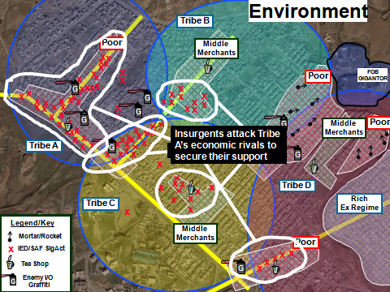

Understanding, not Data
Every area is unique and must be analyzed on its own terms
Notes:
Takeaway: We need to seek understanding of what is really causing violence, not just data. Metrics can be deceptive.
Effective analysis and success in counterinsurgency environments require granular level intelligence. Computer databases, patrol reports, human terrain systems, unmanned vehicles, SIGINT and HUMINT all compete for our attention and overwhelm our analysts. Too often, we become so focused on the latest metric regarding IED attacks, money spent on civil affairs, or number of local leader engagements that we forget to ask “so what?” Our intelligence organizations must be structured to facilitate understanding of the environment from the population’s perspective. They must answer why the enemy is there, and structure intelligence gathering accordingly. Often this kind of intelligence requires spending time on the ground and with the population. Engaging and employing our host nation partners can greatly ease this understanding gap, as it is their culture. Learning to ask the meaningful questions and understanding the answers from the population’s perspective aided us greatly in understanding how to reduce violence effectively.
----------
Update left image with doctrinally-correct symbols

Slide 43
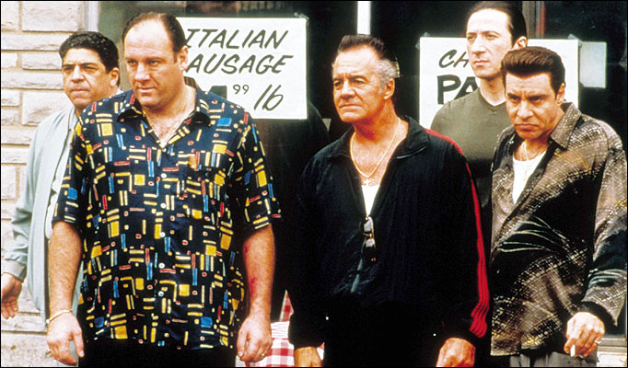
Security Matters
Insurgents leverage insecurity
They won’t help unless you can protect them
Protect the people, and they will help you
“Make them an offer they can’t refuse”
Notes:
Insurgents leverage insecurity to mobilize the population. This subsequently provides the insurgents with recruits, intelligence, food, shelter, medical, and monetary support. Unless we can protect the population of an unstable area continuously, they are unlikely to provide information needed by the counterinsurgent to combat the enemy. It is not unlike the U.S. inner cities where residents often refuse to cooperate with the police to eliminate gang or mafia corruption out of fear. To borrow from a recent book theme, the counterinsurgent must become the “strongest tribe” in the area. This usually means living or establishing a continuous and persistent local security presence. The population must feel confident and protected from insurgent intimidation and retaliation before they will finally come on the counterinsurgent’s side and deliver the critical intelligence needed to decisively defeat the insurgent and/or guerrilla cells.
Quoted by Bing West in his 2008 book of the same name. He cites an Iraqi Army Lieutenant Colonel Ali in the aftermath of second Fallujah(2004) stating, “You Americans are the strongest tribe.” p. 60

Slide 44
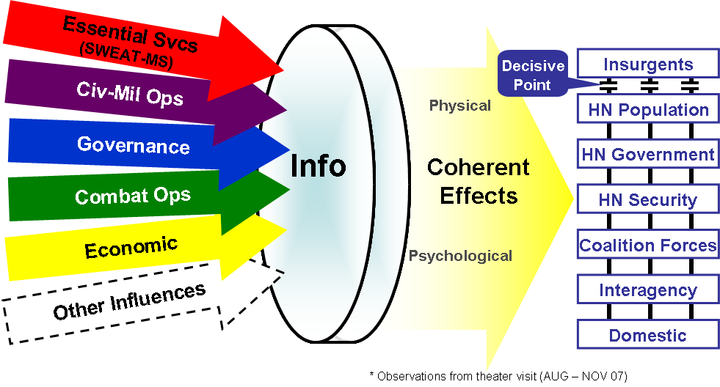
Information as the “Lens” in COIN
“We need an information order with an operations annex”
Coherency in word, actions, images & outcome
Decisive Points
What is your compelling narrative?
Notes:
Takeaway: Since we are affecting people, people are changed through the information we send. Our framing of all operations must be evaluated through the lens of information, to separate the insurgents from the population and connect the population to the government.
Quote allegedly from Adm Mullen – not literally to be true, but understand desired information effect drives operations – that’s what the insurgents do!
Describe criticality of synchronizing your “message” or “narrative” with operations.
-----------
What do you think this slide means?
How many times have insurgents used their narrative to turn a US info engagement against us
Define the narrative first, and then use ops to reinforce it

Slide 45
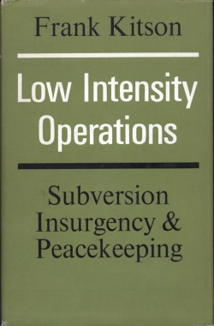
Intelligence
“It is essential that Soldiers and policemen should be trained to get all the information they can by overt means... The main responsibility for developing background information rests with operational commanders and not with the intelligence organization.”
Frank Kitson, Low Intensity Operations: Subversion, Insurgency, and Peacekeeping (1971)
Intelligence Underpins All Other Activities.
Notes:
Takeaway: Intelligence driven operations prevent alienation of the population
But where do we get intel? What does intel driven operations mean? Intel gathering is not just the G2’s job – all echelons are collectors. Many times in COIN good intel comes from the ground as well as above.
----------
Fix line under title
It’s really a policing action; (from audience): in Tacoma policing, we do exactly this—except our “insurgency” problem is gangs

Slide 46
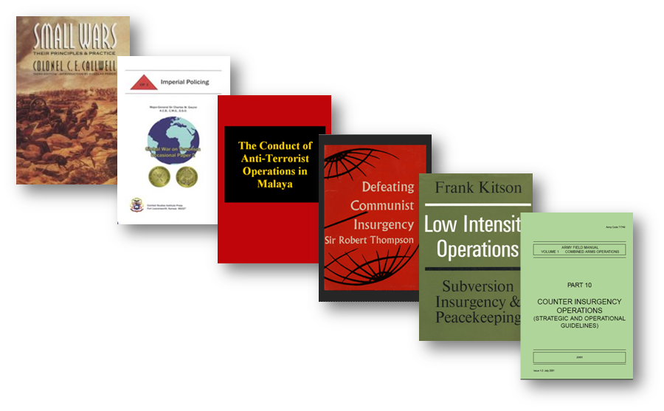
Knowledge is Out There
This is not new … but it is new … use in context!
Notes:
Takeaway: COIN has been well described in the literature over the past 100 years. We need to get back into our books to succeed.
“Until we spend as much time in the library as the PT track we will struggle with these operations”
However, dogmatically applying past principles will not lead to success? The operational environment has evolved – we must use the past as an informed guide and not as a solution – each problem is unique.
----------
While principles are the same, what has changed? We need to apply principles in the new context

